Slide 1
Database project demonstrating a social media site

Slide 2
INTRODUCTION
This database project demonstrates the database management operations of a social media site like Facebook, Instagram etc. This project’s objective is to show the relations between different tables reflecting the data stored for the various users, posts, likes, comments etc.

Slide 3
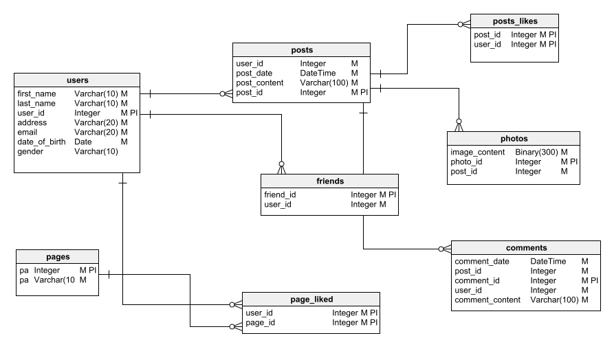
SCHEMA DIAGRAM

Slide 4
REPLICA TABLES (1)
USERS TABLE
First Name | Last Name | User ID | Address | E-Mail | Date of Birth | Gender
Ahmed | Zarif | 1 | Uttara, Dhaka | abc@gmail.com | 2000-08-06 | Male
Shamim | Himel | 2 | Maijdee, Noakhali | bcd@gmail.com | 2000-10-17 | Male
Ahmed | Loba | 3 | Uttara, Dhaka | efg@gmail.com | 2008-01-16 | Female
Umme | Habiba | 4 | Maijedee, Noakhali | hij@gmail.com | 1977-31-12 | Female
Rakib | Mahbub | 5 | KUET, Khulna | jka@gmail.com | 2000-11-11 | Male

Slide 5
REPLICA TABLE(2)
POSTS TABLE
Post Date | Post Content | Post ID | Post Like | Users_User_ID
06 Apr, 2021 | Post one | 1 | 10 | 1
21 Oct, 2020 | Post two | 2 | 7 | 2
14 Sept, 2022 | Post Three | 3 | 8 | 3
06 Aug, 2023 | Post Four | 4 | 11 | 4
01 May, 2023 | Post Five | 5 | 5 | 5
08 Aug, 2022 | Post Six | 6 | 3 | 1

Slide 6
REPLICA TABLE(3)
POSTS LIKES TABLE
User ID | Post ID
1 | 2
2 | 1
4 | 5
5 | 1
3 | 4

Slide 7
REPLICA TABLE(4)
PHOTOS TABLE
Image Content | Photo ID | Post ID
Blob One | 1 | 1
Blob Two | 2 | 2
Blob Three | 3 | 3
Blob Four | 4 | 4
Blob Five | 5 | 5

Slide 8
REPLICA TABLE(5)
FRIENDS TABLE
Friend ID | User ID
1 | 2
2 | 1
3 | 3
4 | 4
5 | 1
6 | 5
7 | 1

Slide 9
REPLICA TABLE(6)
COMMENTS TABLE
Comments Date | Comment ID | User ID | Comment Content | Post ID
04 Apr, 2022 | 1 | 2 | Comment One | 4
26 Mar, 2023 | 2 | 1 | Comment Two | 5
21 Feb, 2021 | 3 | 2 | Comment Three | 3
10 May, 2022 | 4 | 2 | Comment Four | 1

Slide 10
REPLICA TABLE(7)
PAGE TABLE
Page ID | Page Name | Page Content
1 | Cricket | Page one
2 | KUET | Page two
3 | Noakhali | Page three
4 | Radiohead | Page four
5 | Football | Page five

Slide 11
REPLICA TABL(8)
PAGE LIKED TABLE
User ID | Page ID
1 | 4
2 | 1
2 | 2
4 | 5
5 | 3

